Slide 1
How Does the United Way Choose its Locations?
Ben Harwood, Kevin Vogel, Kyle Wass, Nina Williams (in absentia)

Slide 2







Agenda
The United Way
Who they are, what they do, and how they operate.

Slide 3
Agenda
The United Way
The Big Idea
Who they are, what they do, and how they operate.
What’s the study about?

Slide 4
Agenda
The United Way
The Big Idea
A bit About Data
Who they are, what they do, and how they operate.
What’s the study about?
This IS data science, after all

Slide 5
Agenda
The Big Idea
The Path to Success
A bit About Data
What’s the study about?
How to achieve our goal
This IS data science, after all

Slide 6
Agenda
The Path to Success
Results
A bit About Data
How to achieve our goal
And the verdict is…
This IS data science, after all

Slide 7
Agenda
The Path to Success
Results
Conclusion
How to achieve our goal
And the verdict is…

Slide 8
Agenda
Results
Conclusion
And the verdict is…

Slide 9
Agenda

Slide 10

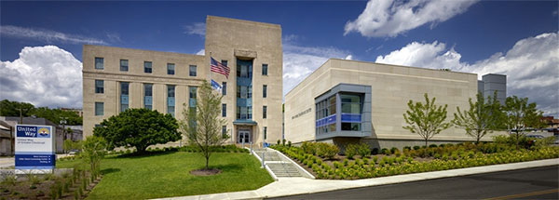



The United Way
1200 branches in the United States

Slide 11
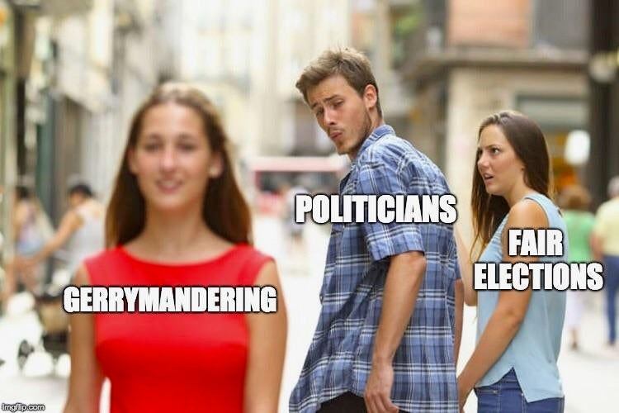

The Big Idea
Cults!

Slide 12
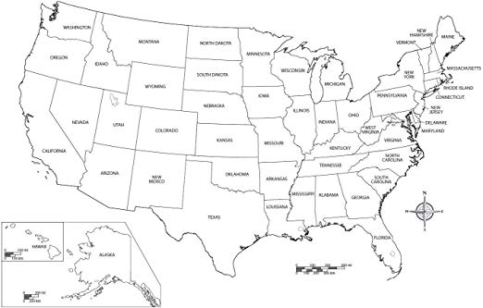

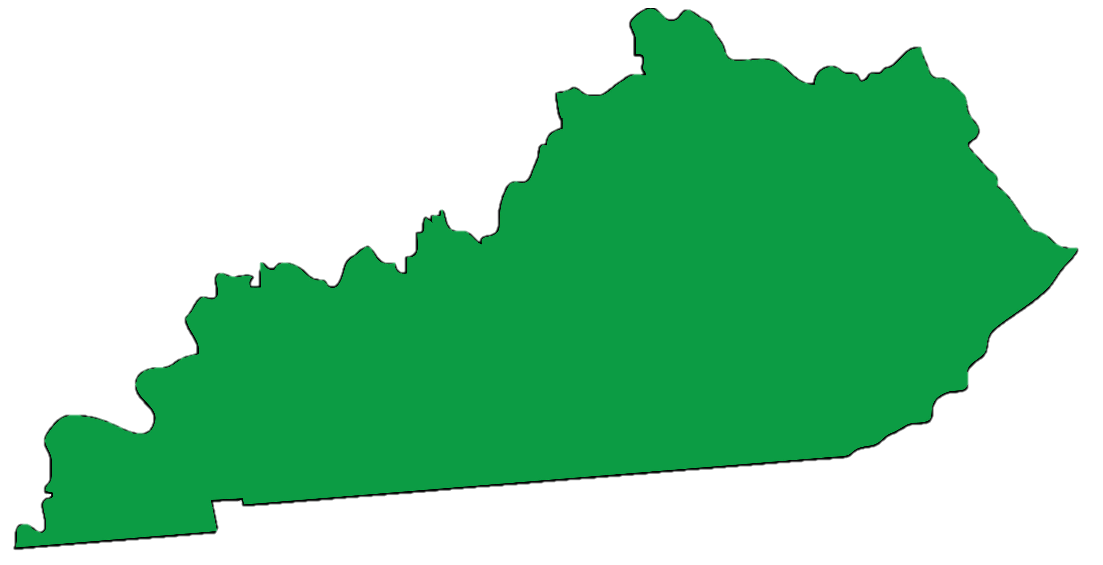

Data

Slide 13

Data

Slide 14
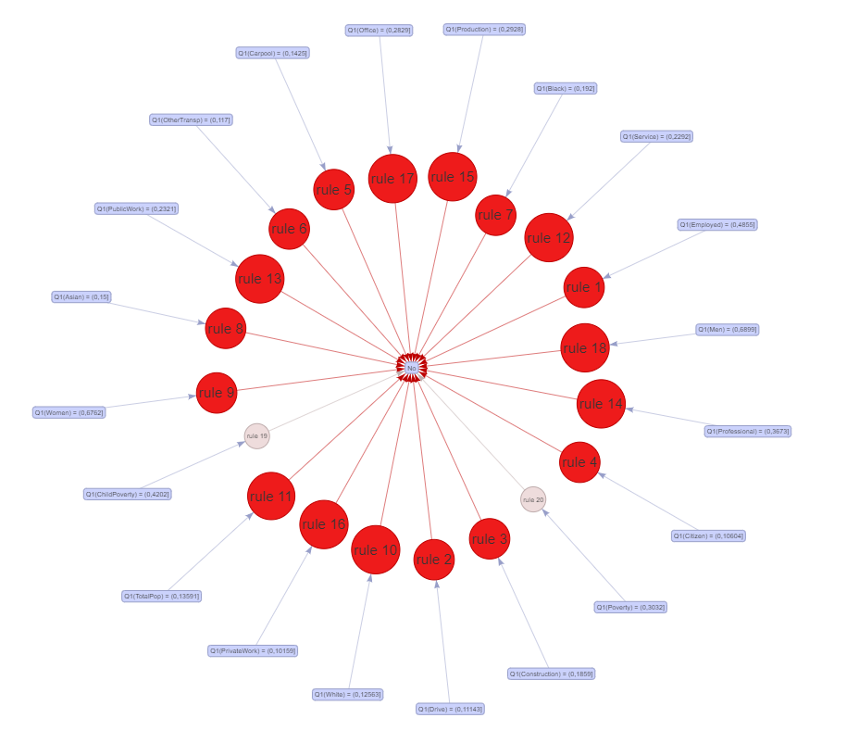
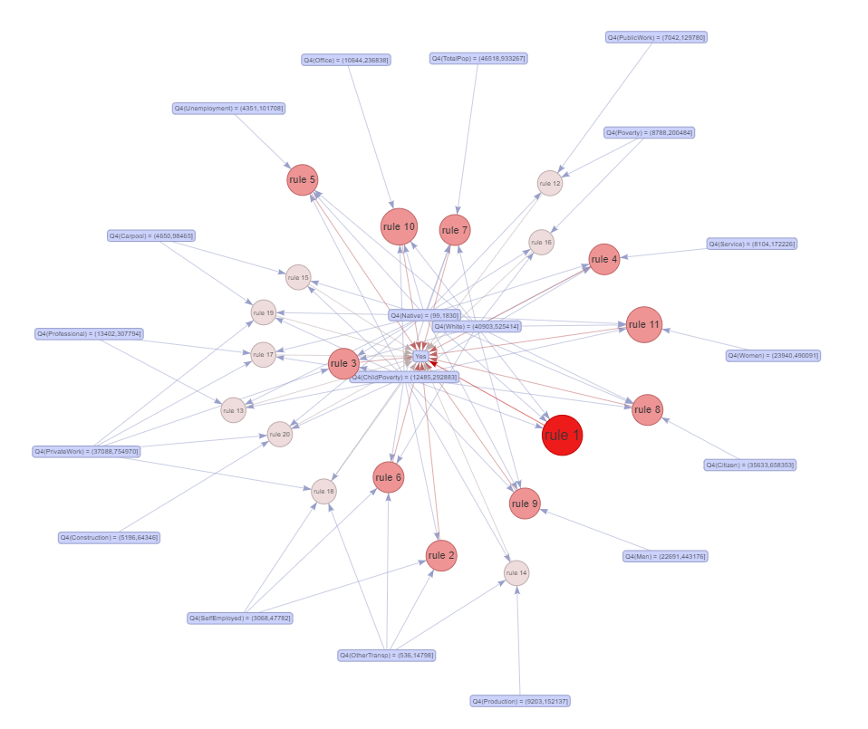

The Path to Success
“Yes rules”
“No rules”
Did he just say the “no” rules had a FLORAL shape?

Slide 15
The Path to Success
No
.74 .26
100%
yes
Poverty < 0.033
no
Yes
.27 .73
32%
OtherTransp <0.037
No
.57 .43 13%
Pacific >= 0.0026
No
.96 .04
68%
No
.90 .1
6%
Yes
.31 .69
7%
Yes
.06 .94
19%

Slide 16
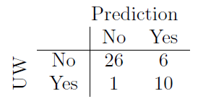
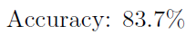
The Path to Success
Observations:
Low poverty implies no United Way location…??
Not super low poverty with not super low numbers of “Other Transporters” has 19% chance of a U-Way location
No
.74 .26
100%
yes
Poverty < 0.033
no
Yes
.27 .73
32%
OtherTransp <0.037
No
.57 .43 13%
Pacific >= 0.0026
No
.96 .04
68%
No
.90 .1
6%
Yes
.31 .69
7%
Yes
.06 .94
19%

Slide 17
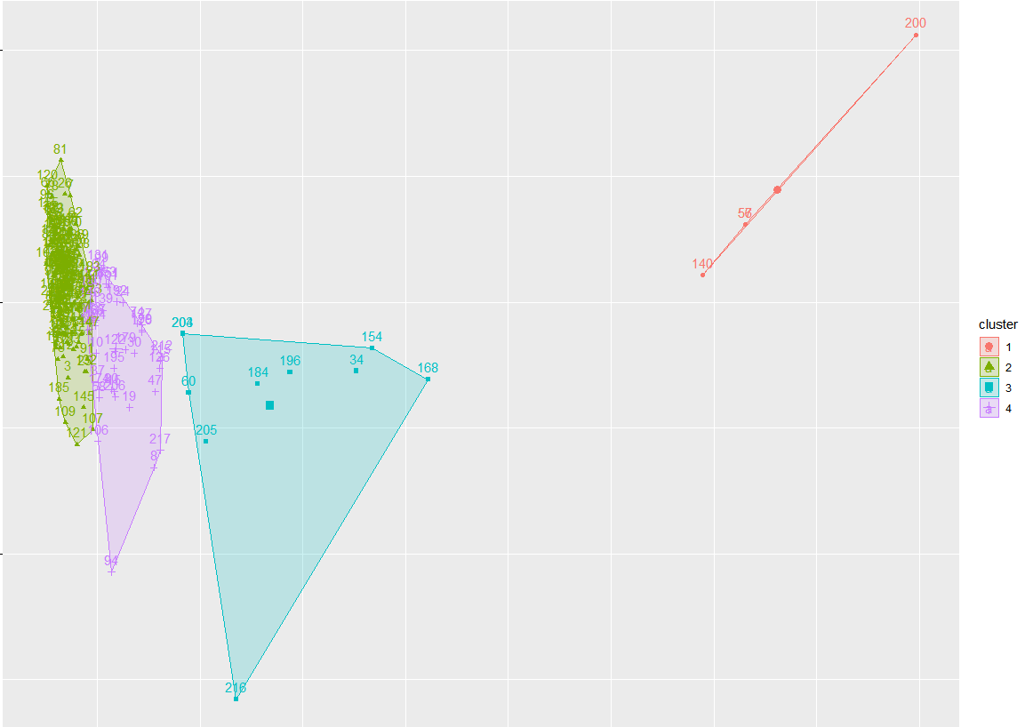

The Path to Success

Slide 18
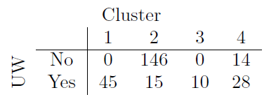
The Path to Success

Slide 19


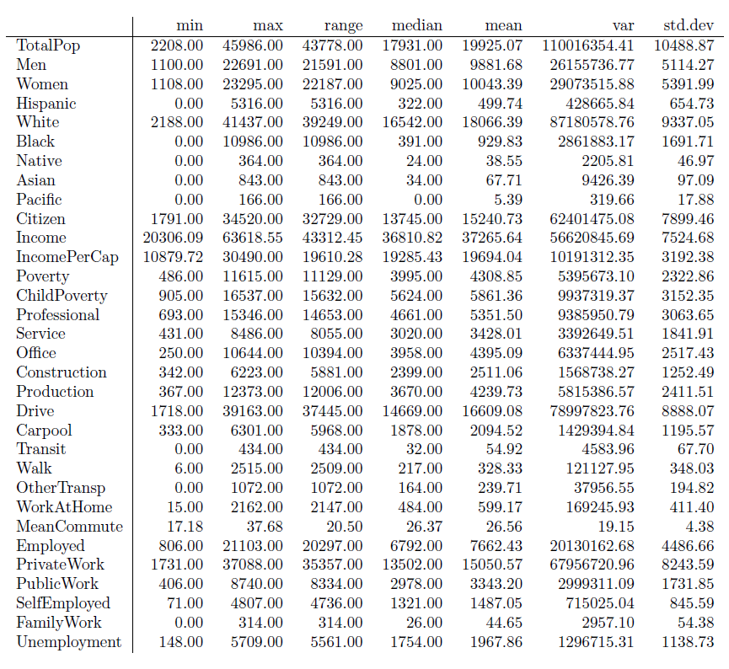

The Path to Success
Summary statistics for
Cluster 2

Slide 20
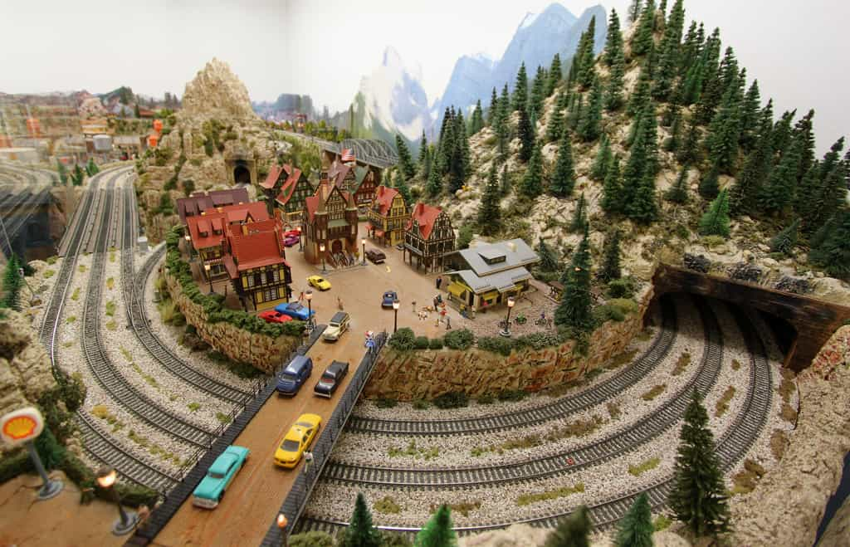
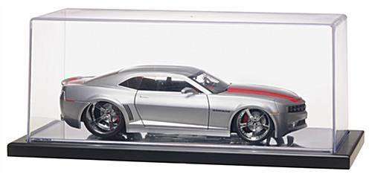
The Path to Success

Slide 21

The Path to Success

Slide 22


The Path to Success

Slide 23
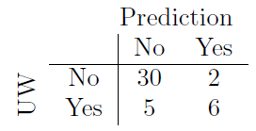


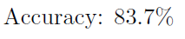

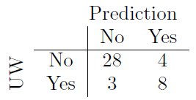
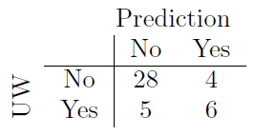
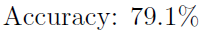
The Path to Success
Neighbors
Linear Algebra
Trees
Probability
P(Y|X)

Slide 24
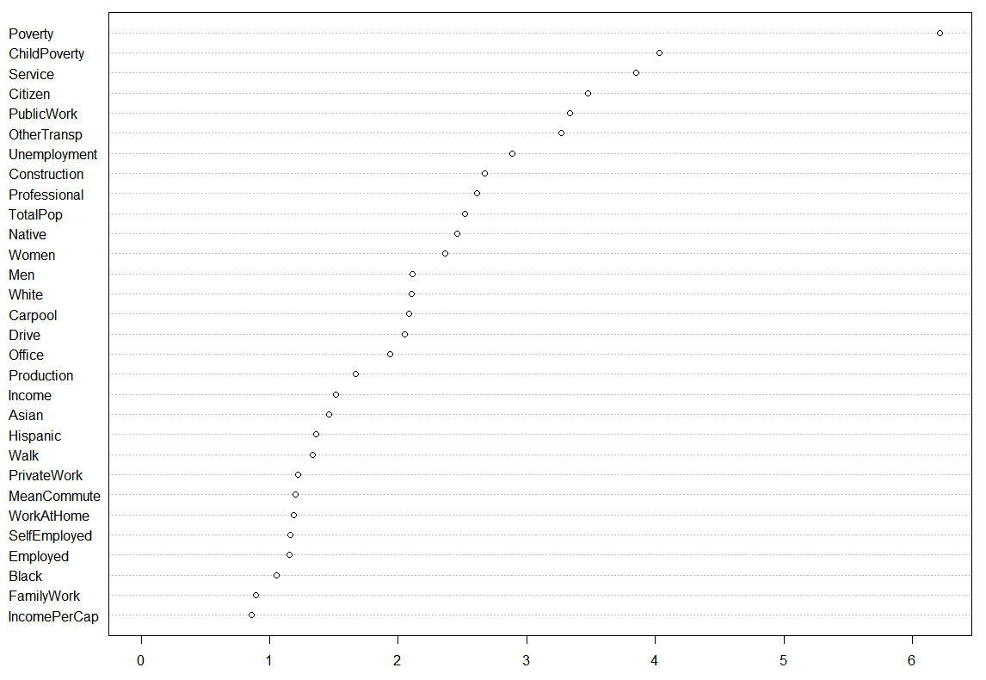


The Path to Success

Slide 25

Results

Slide 26
Results
2
3
1
Very likely that more than demographics influences UW location placement
No model was over 55% accurate when applied to Ohio
OH has more locations than KY and TN combined

Slide 27
Results
2
3
1
Very likely that more than demographics influences UW location placement
No model was over 55% accurate when applied to Ohio
OH has more locations than KY and TN combined

Slide 28


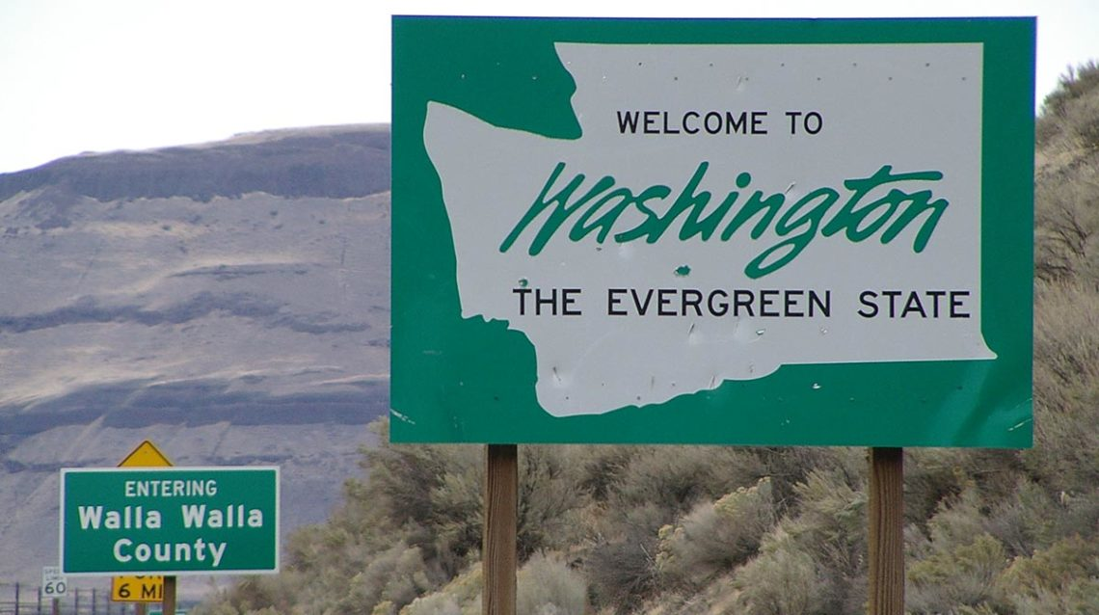


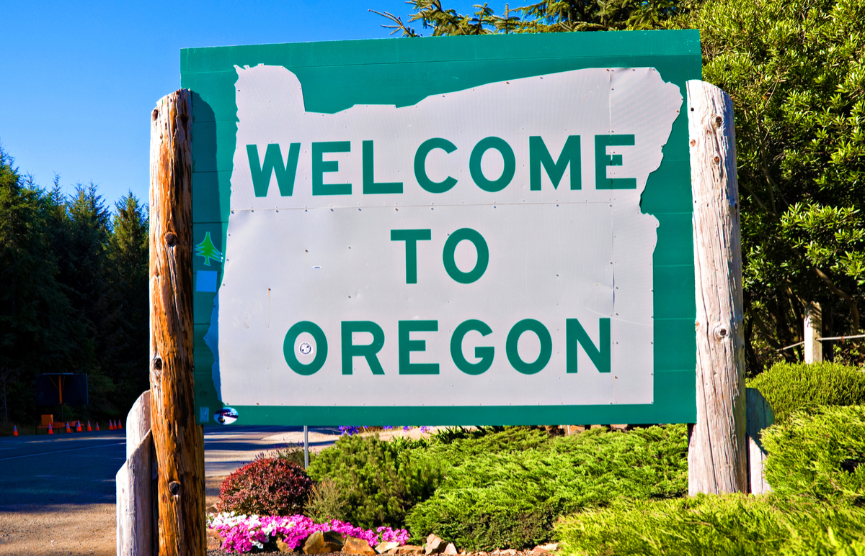
Conclusion
No model was over 55% accurate when applied to Ohio
Very likely that more than demographics influences UW location placement
OH has more locations than KY and TN combined

Slide 29
Thank you
The United Way
Who they are, what they do, and how they operate.

Slide 30
Thank you
The United Way
Who they are, what they do, and how they operate.

Slide 31
How Does the United Way Choose its Locations?
Ben Harwood, Kevin Vogel, Kyle Wass, Nina Williams (in absentia)

